Slide 1
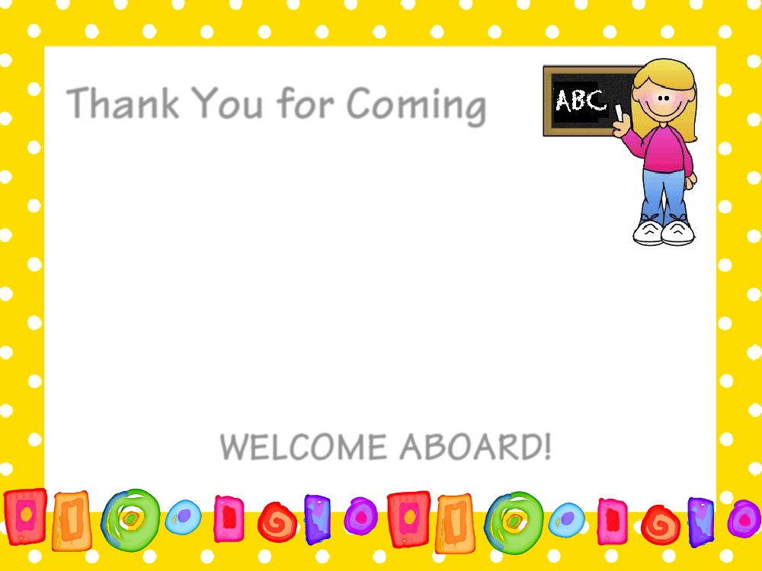
* Meet the Teacher Directions Welcome 1st Grade Families!
Please check how your child will get home from school and your email address. Please make any changes with red ink.
I am updating my National Board Certificate this year. You may fill out and sign the Student release paper (you can send it in later).
You may sign up to be a volunteer on the sheet in your packet.
I will email family members who are interesting in volunteering.
Have your child write his/her nametag and pick a desk. The packets on the desk are yours and includes homework for you and your child. Please take it home today. Feel free to look through the packet and ask any questions.
If you would like to donate an item to our class, please see my Amazon wish list.
Have your child visit Mrs. Dafoe!
Please feel free to look at the curriculum materials on the front table…don’t hesitate to ask any questions.

Slide 2
Curriculum Information
* Please let me know if you have any questions at Meet the Teacher.
WELCOME TO FIRST GRADE!

Slide 3
National Board Certification
I previously went through the rigorous process to become National Board Certified in the area of Early Childhood Generalist. Every five years I need to maintain my certification by demonstrating knowledge and practices that are expected of an accomplished teacher, improve student learning and encourage excellence in teaching. Part of the process requires me to video me teaching in which your child may be visible and may include photos of your child’s work. The team who evaluates me will be looking at my teaching abilities and plan on helping students achieve academic success based on a student’s abilities. I am not allowed to disclose state, school, student names or even my name in anything I submit. With that said, I need to have your permission to have your child in the video and use his/her work image. Please note the evaluators will be the only ones seeing the video and student work. All students may not be seen in the video, and I will only be choosing a select number o work samples.
In the Meet the Teacher packet will be a Student Release form. I will need all students to submit a form and either give me permission or not give me permission. If you have any questions or concerns, please don’t hesitate to ask.

Slide 4
Suggested School Supplies
Everyone will need
*1 ½ inch 3 ring binder with a clear pocket in the front for our “First Grade Scrapbook”
*Backpack
*pencil box which can fit these items
3 or more glue sticks (there are great sales on these now!)
1 package of #2 sharpened pencils
1 package of crayons (please make sure that it fits in the pencil box)
1 highlighter (any color)
Quarter 1 Amazon Wish list Link: https://www.amazon.com/hz/wishlist/ls/3EOCTVEMEH9KF?ref_=wl_share
Other Optional Donations beyond Amazon Quarterly Wishlist:
*Wal-green’s gift card (print photos for scrapbook)
* Fry’s gift card (I will purchase foods throughout the year for special activities. For example, first day of school “Jitter Juice”, which is lemonade. 😊)
Thanks so much for helping our classroom!

Slide 5
Teacher's Name: Wendy Dafoe
Email: Dafoe.Wendy@cusd80.com
Phone: 480-224-3400
Website: http://www.cusd80.com/Domain/3495
I am happy to talk with you about your child at any time, however, out of respect for my students' privacy, I do not discuss student progress when I have other students in the classroom. If you wish to discuss your child's progress, please contact me to schedule a conference.*
I will respond within 24 hours. Thank you for understanding.

Slide 6

Birthdays
Birthdays are extra special for First Graders!
Feel free to send in store bought treats (school policy). Please include napkins if it's a messier treat. Prior to buying treats, check with me for our class size, as it changes frequently throughout the school year. (We will eat the treats outside before recess.)
Please only send party invitations to school if you are inviting our whole class. Summer birthdays kiddos will have an opportunity to celebrate with the class in May.

Slide 7




Snacks
Please provide a daily snack for your child to eat during snack recess time in the afternoon. If your child forgets a snack for the day, I will have extra snack in a bin in the classroom for him/her. This extra snack bin is for emergencies only and should not be accessed daily for snacks.
Healthy snacks are encouraged! Please refrain from sending in any snacks that contain nuts, due to nut allergies! THANK YOU IN ADVANCE!!!

Slide 8
Behavior Management
The whole school will be implementing the Keys for Success. (Positive Behavior Intervention System of Support). This will include:
Use of a behavior flowchart
Use of reflection forms that will be used school-wide
Reflection forms will be a communication tool between school and home
Students can earn tickets to win prizes in the areas of respect, responsibility, kindness, safety, and grit.

Slide 9


Keys for Success Expectations

Slide 10
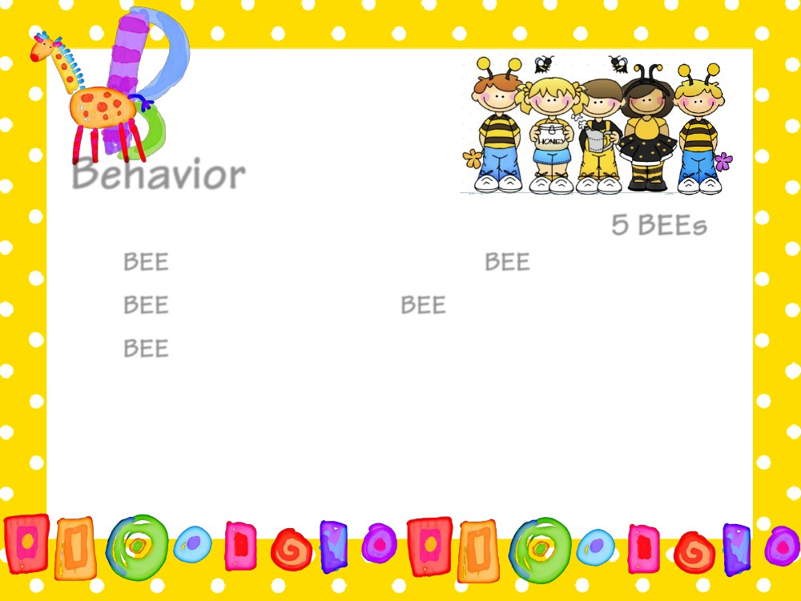
Clip Chart

Slide 11
Clip Chart
Your child has a behavior chart in their homework folder. He or she will fill this out daily so you will see how they are doing. Likewise, there will be consequences for students that choose to break the rules such as writing a "Think about it" sheet, time out, parent contact, or in extreme cases, a visit to the principal's office.
Positive Behavior:
First semester: Bucket Filling Cards!
-When students make good choices, they earn punches on their “Bucket Filling Cards.” When the punch card is full, students get Treasure Box!
Second semester: Dafoe Bucks!
-When students make good choices, they earn “Dafoe Bucks” which can be spent on rewards of their choice.

Slide 12
Homework
Your child will bring home a homework folder each day. This
folder will help your child learn to be responsible and
organized! It also provides a place to put notes or graded
papers your child needs to take home or return. Please check
this folder daily!
A homework packet will go home each Friday and is due back the next
Friday morning. First graders are also expected to read a book of
their choosing for 15 minutes per night. Research has shown daily
independent reading to be one of the most important factors
in predicting student success in school.
Please encourage your child to read daily, and ask questions about what
he/she is reading! Homework completion is documented on the report card and is necessary for their participation in Responsibility Club.

Slide 13
Sight Words & Baggy Books
Your child will need to practice sight words weekly. The goal at the end of 1st grade is that your child knows at least 200 sight words and read 47 words per minute. I have a sight word list that you practice on my website.
http://www.cusd80.com/Page/22471
Your child will, also, be bringing home weekly a baggy book at his or her level. Please have your child read the baggy book, ask them questions about what they read, and then return it so they can get another one. I will assess reading levels quarterly and change book levels accordingly.

Slide 14
Healthy Kids
A child must not be in school and will be sent home if the following condition(s) are present:
1. Fever 100 degrees or higher. A child must be fever-free for 24 hours (without medication before returning to school.)
2. Persistent cough.
3. Sore throat with fever and/or white spots on the throat-if strep throat is diagnosed, the child must be on antibiotics for 24 hours before returning to school.
4. Rash with fever illness, such as chicken pox, measles, etc.
5. Nausea, vomiting, or diarrhea. A child must be free from symptoms for 24 hours before returning to school.
6. Red, itchy, and draining eyes. If conjunctivitis or "pink eye" is diagnosed, the child must be on antibiotics for 24 hours before returning to school.
7. Prolonged headache and/or stomachache.
8. Swelling or pain at a level that may interfere with learning.
9. Earache.
10. Toothache.
11. Head lice - A child must remain at home until treated with medicated lice shampoo and the nits are removed. The child must be cleared through the health office before returning to school. CUSD enforces a no-nit policy.

Slide 15

Specials
Specials have been increased to 40 minutes and every day for the quarter will be the same special. Your child will have a sheet with specials in his/her homework folder. I also have them posted on our class website. Please be sure that your child comes to school each day with proper shoes and clothes so that he/she may participate on P.E. days.
*Our special time will be from 1:30-2:10 daily.
We have P.E. the first day of school!

Slide 16

Drop Off and Getting Home
Drop Off
*Bus tags –go on backpacks
*Closed campus except for the first day!
*Wednesday morning: cones by the basketball courts with teachers’ names. We are the yellow square.
Pick Up – NEW this year!
*We will be using a pick up app. All students who normally would have gone outside will need to have their family placard scanned to be picked up.
*Placards will be given to the youngest member in the family to bring home.
*Kids Express will be walked to the gym by Kids Express teachers.
*Bussers will be walked to the bus by a first-grade teacher.
*After School activities will be walked to the correct location by a first-grade teacher.

Slide 17


Water Bottles
It’s HOT! Please send in a water bottle with your child each day, making sure their name is on it! The fountains will be available along with bottle refill stations available. Please do not send liquids other than water.

Slide 18


Slide 19


Thinking Maps
Thinking Maps are visual teaching tools that foster and encourage lifelong learning. They provide students with the skills to be successful thinkers, problem solvers, and decision makers.

Slide 20
Field Trips
Made possible by your
tax credit money donations.
THANK YOU!
We are hoping to go to…
Schnepf Farms
Children’s Museum of Phoenix
Harkins (for literacy comparison of movie and book)
All students will be required to pay a $25 ECA fee on Infinite Campus before our first field trip. If this fee is a financial difficulty for your family, there is a waiver available.

Slide 21




What Does It Take To Fund A Field Trip, Performance, or On-Site Activity?
Cost of Sample Field Trip:
1st Grade Childsplay Performance
(Based on 120 Students)
Admission: $1,200.00
Transportation: $ 550.00
Total Cost: $1,750.00
Why Do We Need Both ECA Fees & Tax Credit Donations?
Extra-Curricular Activity Fees Do Not Cover Total Costs of Trips. Example:
$5 Activity Fee X 120 Students = $600.00
Total Cost of Trip: $1,750.00
Activity Fees Collected: - $ 600.00
Still Needed To Fund Trip: $1,150.00
*If we do not have tax credit donations
to cover the remaining cost of trip, there
will be no trip.
Funds Come From:
1. Extra-Curricular Activity Fees
EXAMPLE: $5 per student, per activity fee is charged (with the exception of extended day or overnight trips). Fees must be charged BEFORE a student
attends trips, etc. according to
Attorney General’s opinion.
&
2. Tax Credit Donations
Who Can Make A Tax Credit Donation?
Any Arizona taxpayer (Aunts, Uncles, Grandparents, Neighbors!) can make a tax credit donation, regardless of whether or not they have children in school or live in the Chandler Unified School District.
How Do I Pay ECA Fees & Make A Tax Credit Donation?
Parents/Guardians will pay fees and make donations through their Parent Portal account. Others can make donations through the tax credit online site provided on our website @ www.chandlerdonations.org.

Slide 22
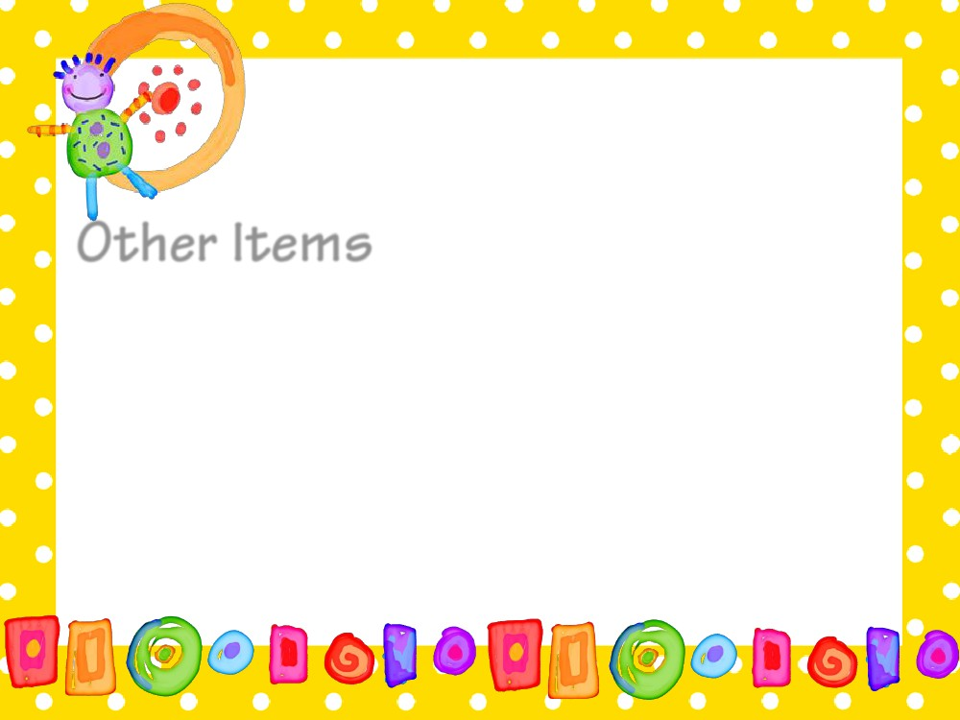
* Star Student of the Week-dates are on the calendar on our website
* Volunteers – Stay Tuned! Please fill out the form in the packet.
*Newsletters-will be posted weekly on website and emailed home
* Please make sure you sign up for Parent Square. I will be sending many reminders through this platform. It is my understanding you will need to sign up to see our website.
*If you have a question, please don’t hesitate to ask. There is a lot of new routines and information…if you are unsure, I am sure another family has the same question!

Slide 23
Mrs. Wendy Dafoe
Email : Dafoe.wendy@cusd80.com
School Phone: 224-3447
Cell Phone: (480)294-5758
Website: https://www.cusd80.com/Page/22463
I am happy to talk with you regarding your child at anytime. I am typically at school by 6:30 am, but usually leave at 3:30 pm for my other job. You will see that I have included my cell number. Please text me first and I will call you, as soon as possible. I ask that you do not discuss your child while other children are present. I would be happy to schedule an in-person , google meet or phone conference for your child’s privacy. I will respond within 24 hours. Thank you for your understanding.
I am so excited to begin the 2024-2025 school year! My goal is to make this year successful for your child while keeping them safe. I am a strong believer that an awesome first grade year requires us to support each other, and I am looking forward to working with you!
Wendy

